Slide 1
EUMETSAT Operational Status - 2009
Simon Elliott
Meteorological Operations Division
simon.elliott@eumetsat.int

Slide 2
Spacecraft Operations
MET-9 at 0°→ Prime mission. A Safe Mode in August 2009 (after the one in April 2009) due to a Single Event Upset (SEU) on the on board computer.
MET-8 at 9.5°E → Backup to Met-9 and RSS. No significant in-orbit anomalies to report. The S/C is beyond its specified lifetime (i.e. 7 years). Successful NS inclination manoeuvre in Oct 09.
MET-7 at 57.5°E → IODC service. No new in-orbit anomalies to report. A few tests to define a new S/C configuration are planned to support the IODC DCP mission during eclipse.
MET-6 at 67.5°E → IODC DCP and backup to Met-7. No new in-orbit anomalies. A re-orbiting date for Met-6 is under definition (worst case → Autumn 2010).

Slide 3
MTP ground segment
MPEF: Met-7/MSG cross calibration on going.
BMCC (Fucino): activation on 23-11-09.
CF: Procurement of new DS15 Alpha computers authorised.
MSG ground segment
PGS
  High rate DCP testing continues
  Antennas periodic maintenance during RSS interruptions

Slide 4
MSG ground segment
IMPF
  IMPF modifications for MSG-3/4 (HW and SW) by April 2010
  IMPF Reprocessing by June 2010
DADF
  New DCP facility development completed by May 2010
  High rate DCP operational in Sept 2010
MPEF
  New MPEF : On-line SW by Jan 2010, Off-line SW by June 2010
CF
  Release 21-260 (with TM propagator) operational by Dec 09

Slide 5
Open Projects
RETIM on EUMETCast: Parallel Operations start Feb 2010 after successful final operational validation and acceptance.
Earth Observation Portal: Centralised registration by Jan 2010
Reprocessing: Environment available by Nov 2009. Start of MTP re-processing H1, 2010. MSG reprocessing after. Adoption of CORE framework for NRT to follow.
MSG-3/4: Ground segment upgrade by April 2010, antenna by Dec 2010.

Slide 6
Multi-Mission facilities
UMARF
  GSICS operational by Dec 09
  Upgrades due to obsolescence (e.g. HW, CORBA) by March 10
SNI
  SAN obsolescent equipment upgrade by Dec 09
  Support to reprocessing by Dec 09
Exgate, EUMETCast
  Implementation of ECPs (MSG and EPS) on going
  New INGATE by Dec 09
OIS: evolution document under preparation
Multi-mission COMMS: UMARF CISCO switchers replacement,
Building Infrastructure: TCE maintenance end Nov 10

Slide 8
Metop-A Status
DHSA: Redundant CCU I/O Board. Further investigation of I/O Board planned following a possible future PLSOL outage.
  Incident raised on ULFAR reception of unidentified command packet header
HRPT:B unit in restricted operation
AMSU A1: Noise on Channel 7 exceeding specification
GOME-2: Throughput testing performed August and September 2009.
IASI: patch uploaded to allow autonomous recovery on certain SEUs (September 2009.)
A-DCS: frequency complaints under investigation
In-plane manoeuvre planned December 2009.

Slide 9
Metop-A Status
Metop-A Major Events
Date | Event
9th Aug 09 | A-DCS 95 % Loss of Messages SEU Caused all high and low rate messages to be lost. → Mission outage 1 day 12:34:00
26th Aug 09 | IASI → SEU event: - Mission outage due to the SEU event (6h 6 min)
7th Sept | IASI → SEU event: - Mission outage due to the SEU event (17h 7 min)
17th Sept | Out-of-Plane Manoeuvre: - Mission outages on HIRS, MHS, IASI,SEM, AMSU,GOME
30th Sept | IASI →Upload of On-board software for autonomous SEU recovery (for pre-defined anomaly signatures)
29th Oct | IASI → SEU event: - Mission outage due to the SEU event (5h 20 min)
Metop-A major events July – 17 November 2009

Slide 10
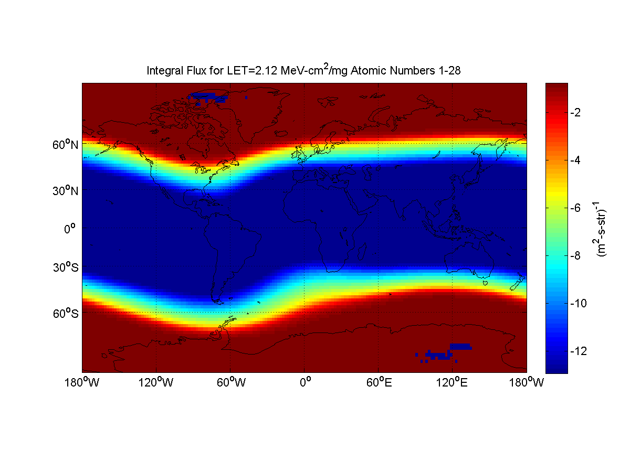
Heavy Ion Risk Assessment – Steady State Flux (NOAA)
Map of radiation Steady State Flux (NOAA):
Blue zone : low risk
Red zone : high risk
Yellow shape : South Atlantic Anomaly

Slide 11
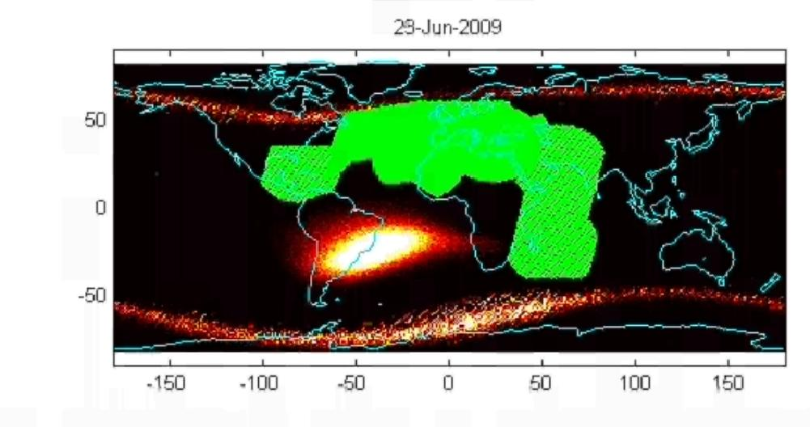
HRPT: Current and future switch-on scenarios
AHRPT reactivation from 29th Sept 08
Zone extension from May 25th 09
Under investigation: Globalisation of AHRPT service…
Proton Testing: Refinement of SAA zone operations

Slide 12
Metop-A HRPT Service Way Forward
Metop-A HRPT SSPA transistor proton testing failures indicate that SAA boundaries cannot be crossed.
Expansion of the global coverage will also have a higher level of risk than considered previously taking only heavy ions into account: it is not currently clear how significant a risk this is
If NOAA-17 is no longer capable of providing a morning orbit HRPT service, then there will be a stronger incentive to expand the coverage.
Risk analyses and expansion preparations (including identification of Metop-HRPT ready ground stations) is to be made in readiness for a possible expansion.
Target is HRPT survival until Metop-B finishes commissioning successfully

Slide 13
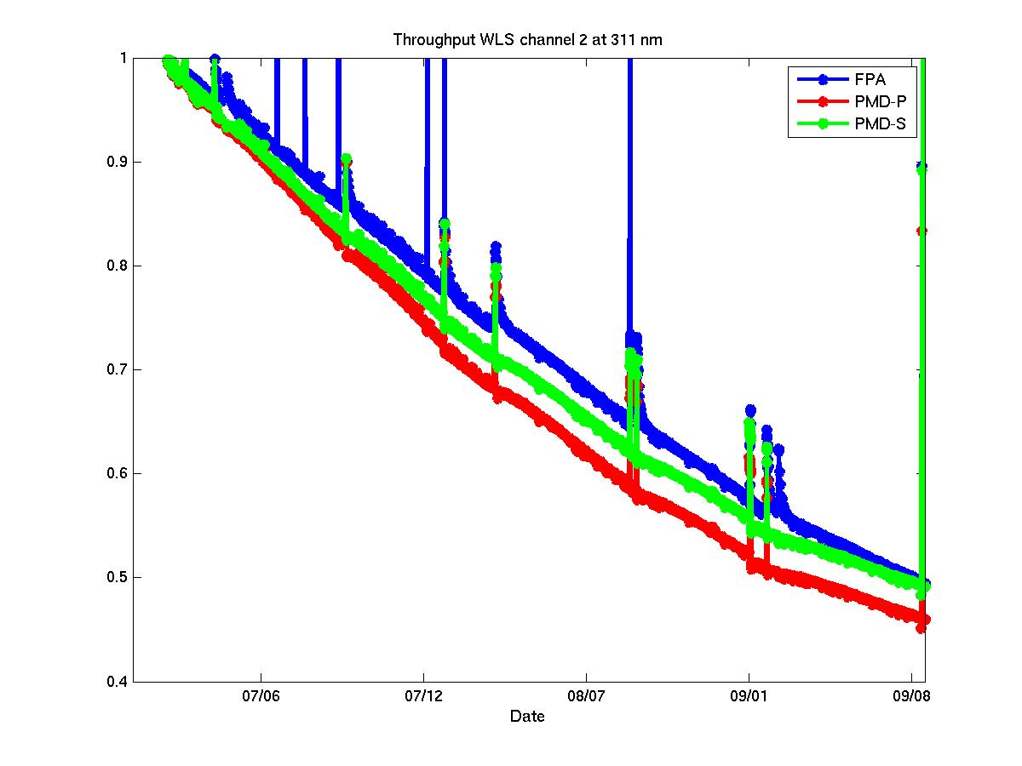
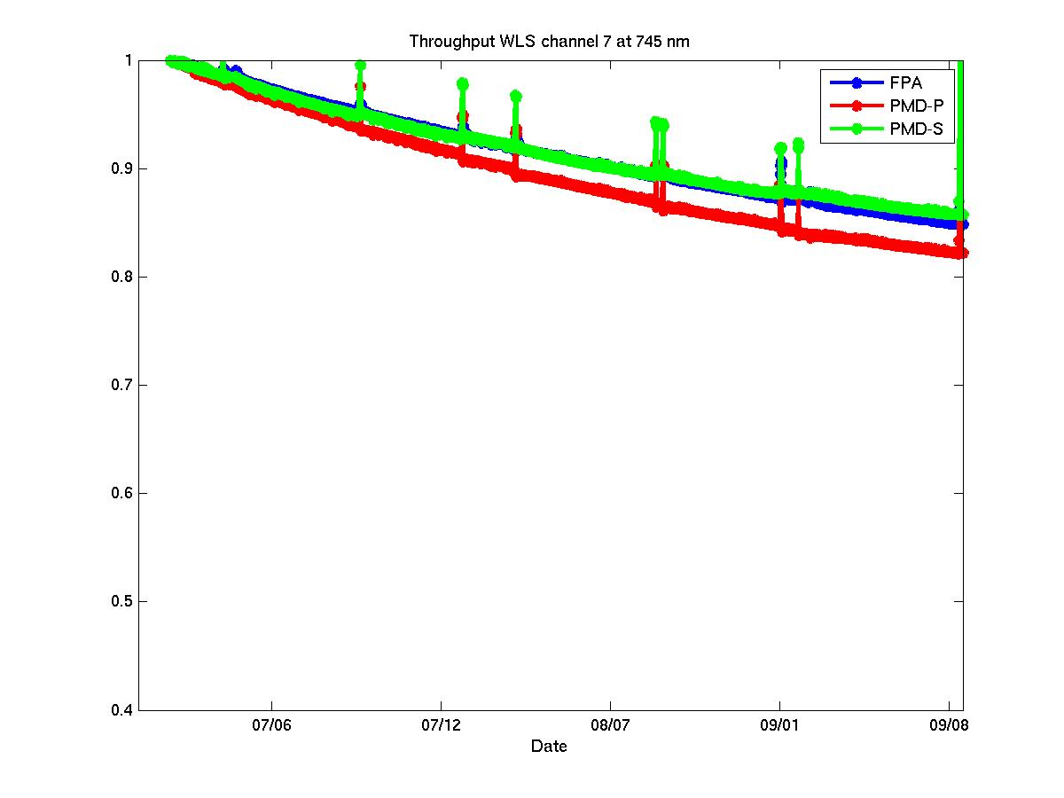
GOME-2 signal decrease (throughput decrease)
SMR signal relative to 1st of January 2007
311 nm
745 nm
1st Jan 07
31st Aug 09
1st Jan 07
31st Aug 09
FPA – Main channel detectors
PMD-P – Polarisation Measurement Device P
PMD-S – Polarisation Measurement Device S

Slide 14
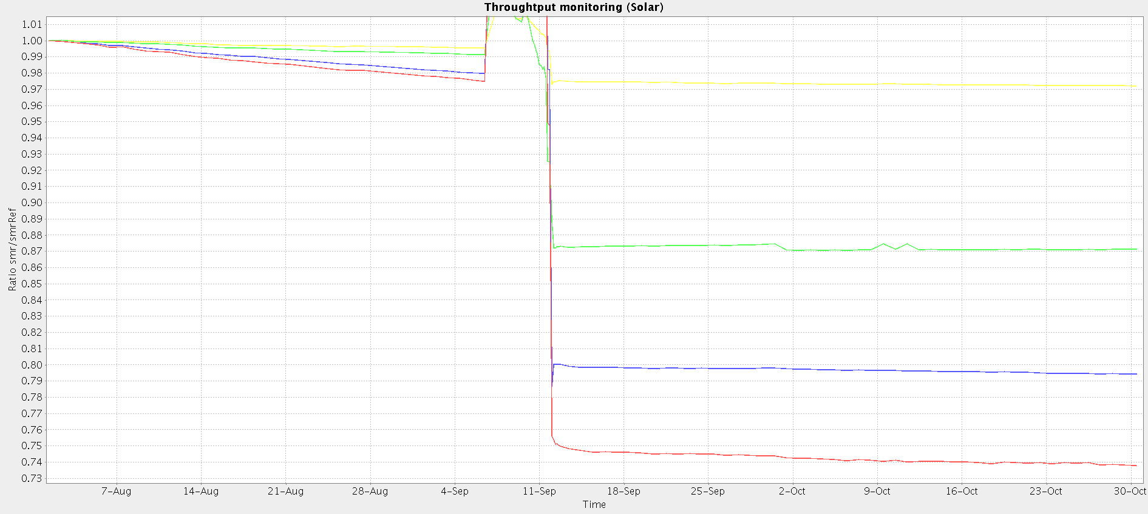
GOME-2 signal before/after throughput test
SMR signal relative to 1st of August – various wavelength main channels
FPA1 265nm
FPA2 320nm
FPA3 440nm
FPA4 640nm
Throughput Test Period

Slide 15


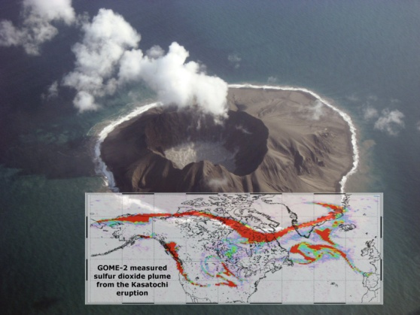
GOME-2 recent scientific publications
IEEE- J-STARS - Fostering Applications of Earth Observation of the Atmosphere
GOME-2 monitoring of the Ozone hole
SO2 from GOME-2 after Kasatochi volcano eruption from August 7, 2008

Slide 16
Ground Segment Operations
Polar Site Facility:
  Boresight tower now working
  L-Band downlink problem is now fixed. This allows NOAA spacecraft downlink for either polarisation.
  X-Band tracking investigations continue, a potential solution has been identified regarding the configuration
The next BUCC upgrade and activation is planned for the next 2 weeks.
The H/W OS upgrades are ongoing (see Metop-B/C presentation).

Slide 17
EPS Operations Planning
2010:
  Approach to Metop-A EOL operations to be agreed
  Operational debris warning service from NOAA / USAF expected to be activated
  Ops Prep for Metop-B to be performed.
2011:
  Antarctic Data Acquisition Demonstration Service (McMurdo) to improve data timeliness (9 out of 14 orbits)
  Validation of combined Metop-A/B operations
2012:
  Metop-B launch, commissioning and routine ops start
2014:
  ADA Operational Service Start (all orbits)

Slide 18
EPS Product Operations Status and Planning
Product (M02) | Current Status | Future Status
All Level 1 Products | Operational
ATOVS Level 2 | Operational
IASI Level 2 (twt, clp) | Operational
IASI Level 2 (ozo, trg) | Demonstration | Operational 2010
AVHRR L2 NDVI | Operational
AVHRR L2 Polar Winds | Demonstration | Operational Q1/2010
ASCAT Soil Moisture | Operational
IASI L1 Compressed |  | Demonstration 2010
All Level 1 NOAA-19 products operational.
ATOVS L2 products from NOAA-19 operational
EPS Reprocessing will commence 2010

Slide 19
JASON-2
EUMETSAT is part of the 4-party group operating JASON-2
Earth terminals in Usingen, Germany and in the USA;
NRT processor provided by CNES and operated by EUMETSAT and NOAA;
OGDR Data are generated in netCDF and converted to BUFR for dissemination
New NRT processor (v3) due next month
Addition of significant wave height to disseminated OGDR data after processor upgrade

Slide 20
Third party data services
EUMETSAT receives, tailors as necessary and retransmits third party data as requested by users
MODIS level 1b (MOD02) retransmitted via EUMETCast after spatial and spectral thinning
MODIS fire data (MOD14) retransmitted via EUMETCast
Some difficulties with MODIS file names. Navigation data still required.
SSMI and SSMI/S data used at EUMETSAT for precipitation data processing and retransmitted to users via EUMETCast

Slide 21
EARS Objectives
The Objectives of the EARS Services are to:
Collect Data from Polar Orbiting Meteorological Satellites via a selected set of HRPT Stations;
Process and Retransmit the Data to End Users via the GTS and the EUMETCast (Ku-Band Europe);
Provide a Timeliness adequate for Local and Regional Numerical Weather Prediction applications (typically < 30 min).
The EARS Operational Service Specification is available under http://www.eumetsat.int > What We Do > Satellites > EARS System

Slide 22
Reception of Data from Polar Orbiting Satellites
Global Data Dump
HRPT (Direct Read-Out)
Global Coverage
On-Board Data Storage up to
102 / 204 minutes
Regional Coverage
Immediate Access

Slide 23
The EARS System
Polar Satellite
Local Product Processing including:
Removal of Duplicate HRPT Data
Data Reduction
  AVHRR → Cloud Cover
Compression
  BUFR
  BZIP2
  Principal Component scores
Data Selection
  8461 → 400 IASI Channel
EUMETCast
HRPT
Stations
EARS
Communication
Network
GTS
Users
Local Product
Processing
Improved Timeliness
Bandwidth Savings

Slide 24
The EARS Services
Today
Pilot ATOVS
EARS-ATOVS
Satellites: NOAA 17 + 18
Products: Level-0,
Full 1-km resolution
Timeliness: Better than 15 min
Users: 983
Satellites: Metop
Products: Level-2
(Wind Vectors)
Timeliness: 30 minutes
Users: 392 for ERS-SCAT
+ 241 additional
Satellites: Metop
Products: Level-1,
280 PC Scores +
400 of 8461 Channels
Timeliness: 30 minutes
Satellites: N-15, 16, 17, 18
+ Metop
Instruments: HIRS, AMSU-A, AMSU-B, MHS
Products: Level-1
Timeliness: Better than 30 min
Pilot AVHRR
EARS-AVHRR
Pilot ASCAT
Pilot IASI
02
03
04
05
06
07
08
09
10
11
12
13
14

Slide 25
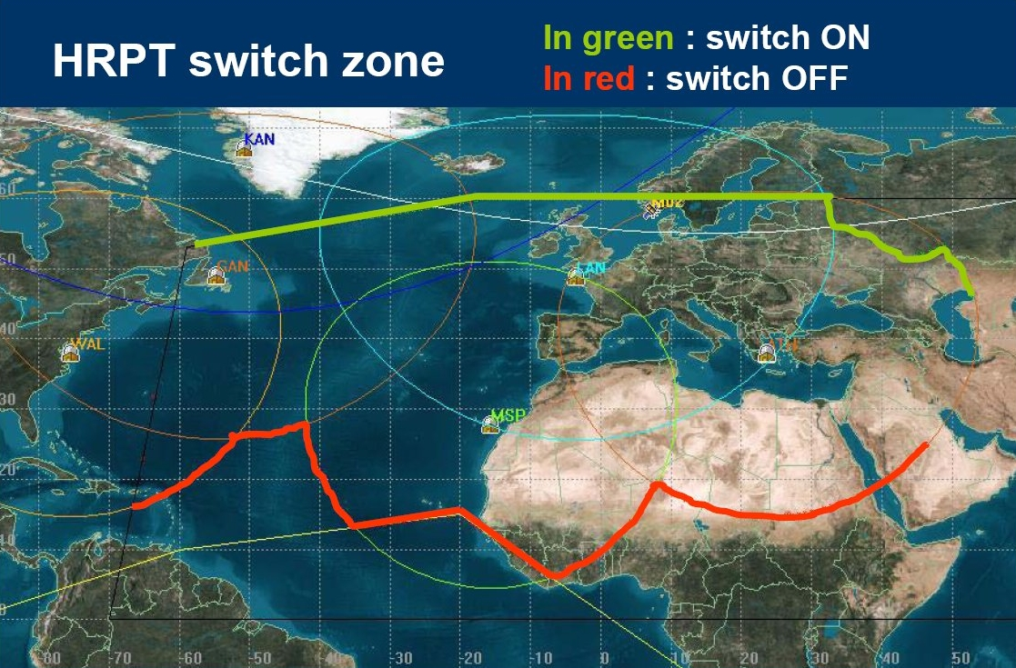
Metop-A HRPT Mitigation Activities
Following Metop-A AHRPT side A failure in July 2007, EUMETSAT has decided to implement a "partial" AHRPT service in those areas where the risk of damage from heavy ion radiation is reduced. For southbound passes, AHRPT side B is activated for all orbits over the North Atlantic and European area starting at around 60°N. The trial service started in September 2008.

Slide 26
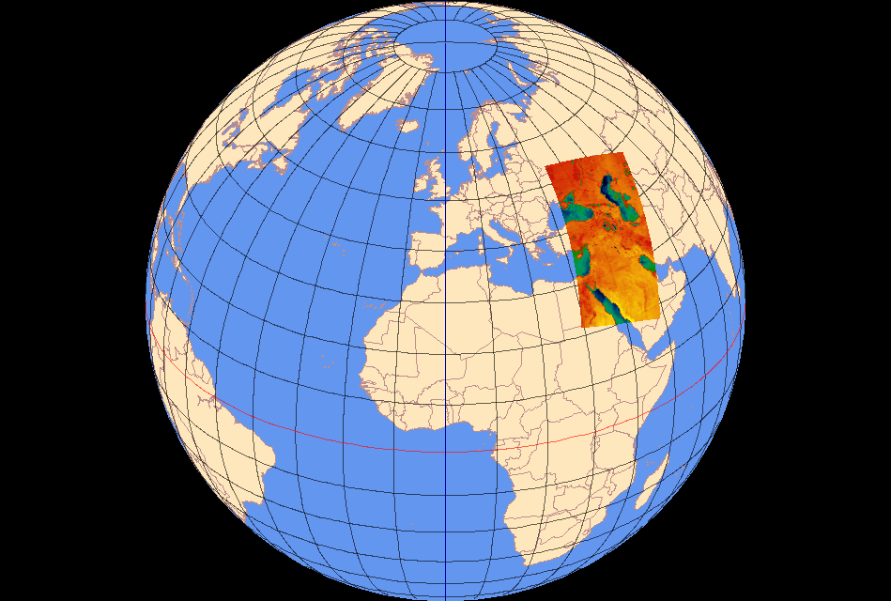




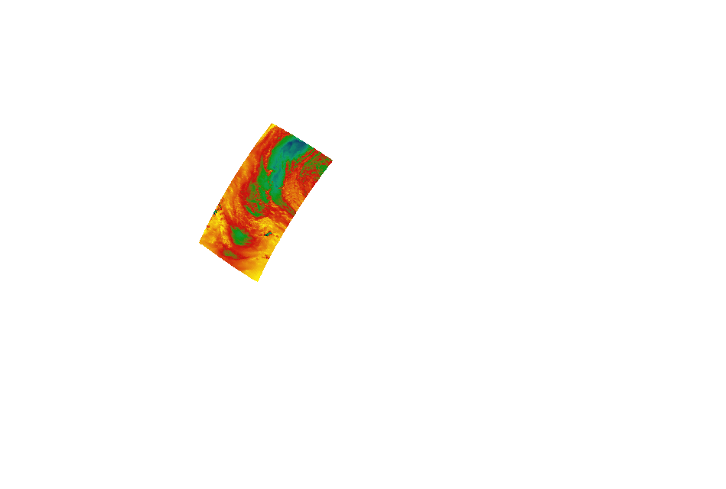
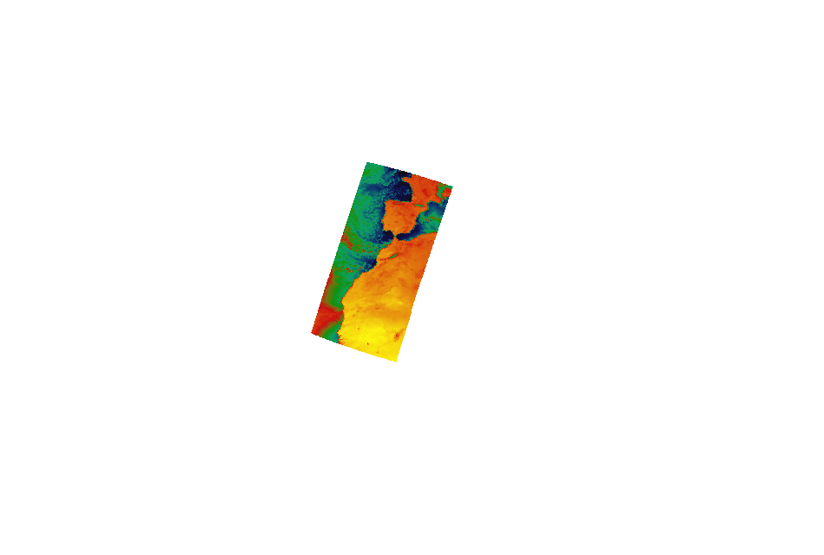
Metop-A HRPT Mitigation Activities
Metop-A L1c products from Athens, Lannion and Maspalomas HRPT stations 25 Nov 2008 – Orbits 10905 to 10908 - MHS Channel 1

Slide 27
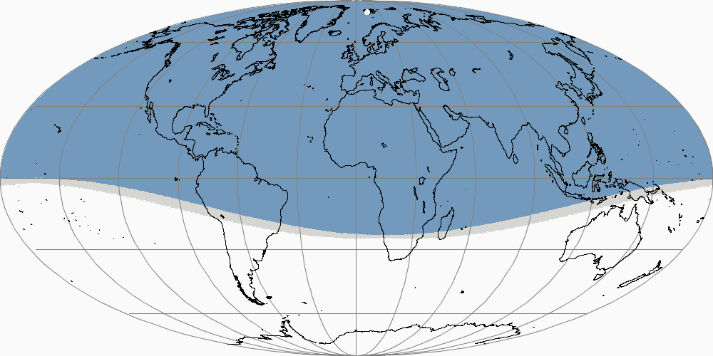
Metop-A HRPT Mitigation Activities
To complement the “partial” AHRPT service, a Fast Dump Extract service is being implemented. This service comprises the most recent part of the X-band global dump received at Svalbard from the northbound passes and processed by the EARS system for ASCAT and ATOVS, and in the future for AVHRR.
Timeliness of EARS products between 20 and 45 minutes.

Slide 28
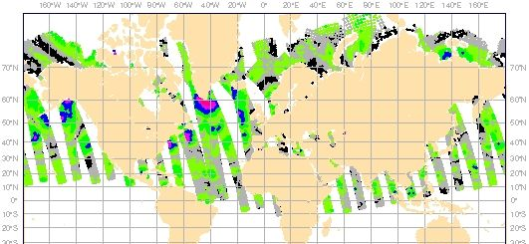
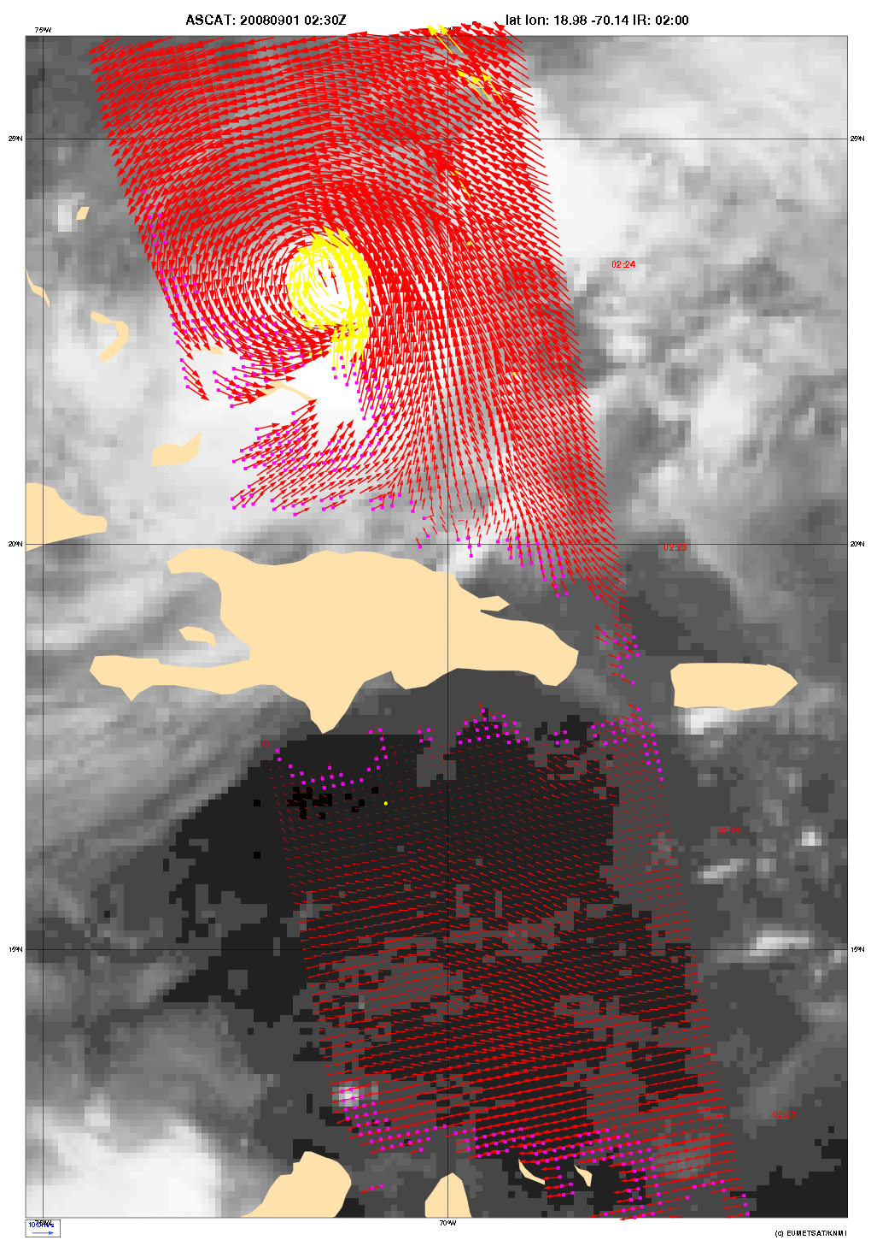
Metop-A HRPT Mitigation Activities
EARS-ASCAT L2 products coverage from the X-Band Fast-Extract System:
KNMI perform L2 processing of EARS-ASCAT products (wind speed and direction over the oceans at 12.5 and 25 km resolution).
Planned start of dissemination: 16 December 2008.

Slide 29
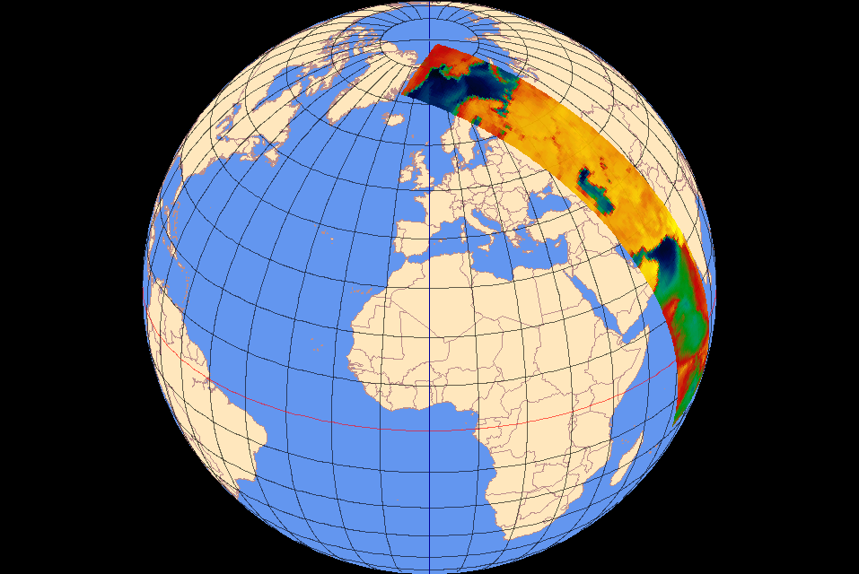
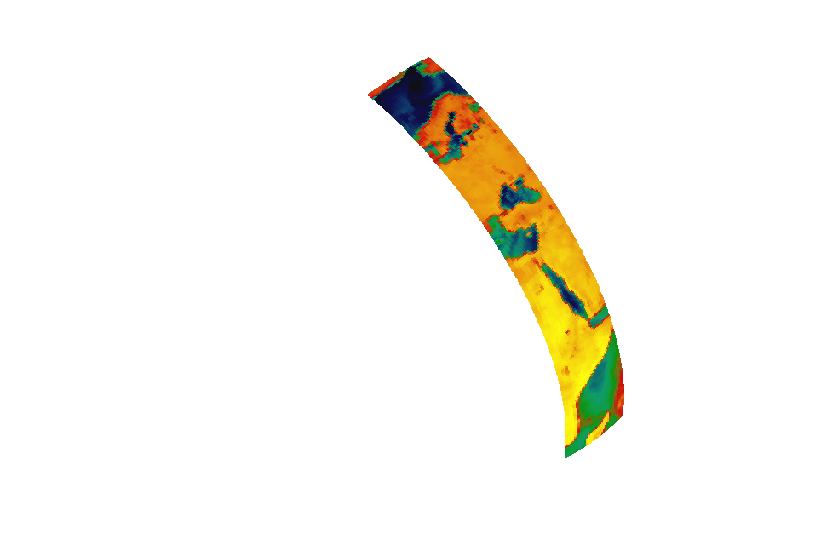
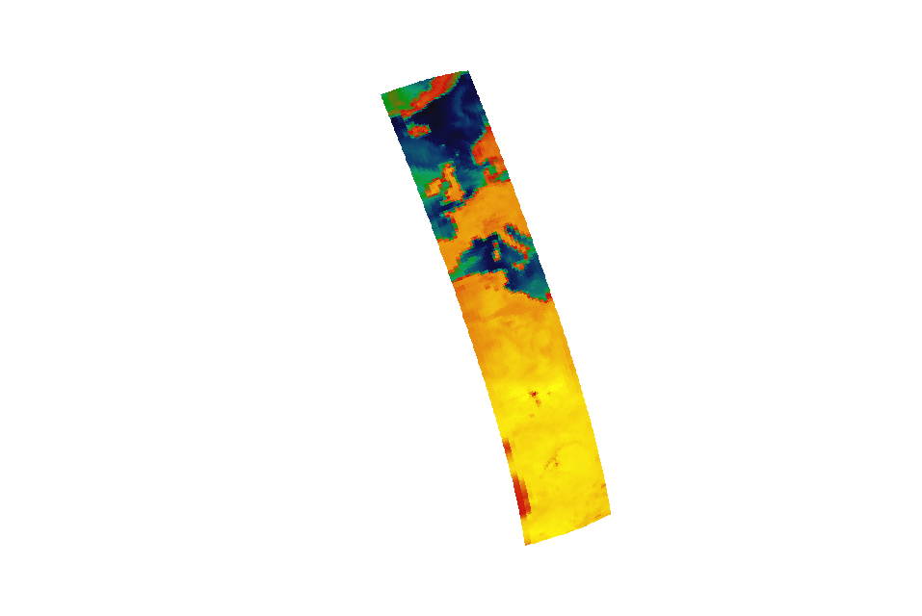
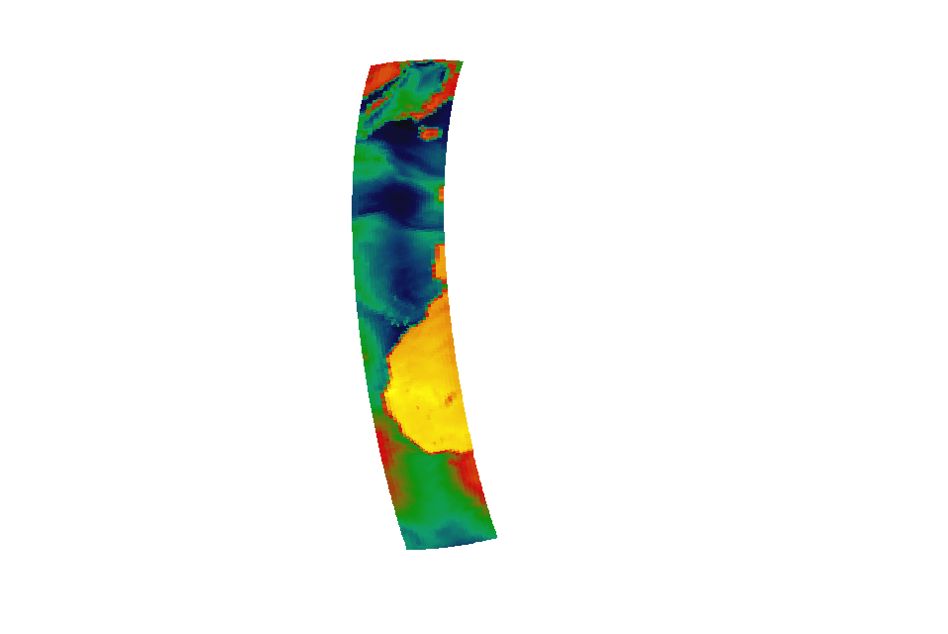
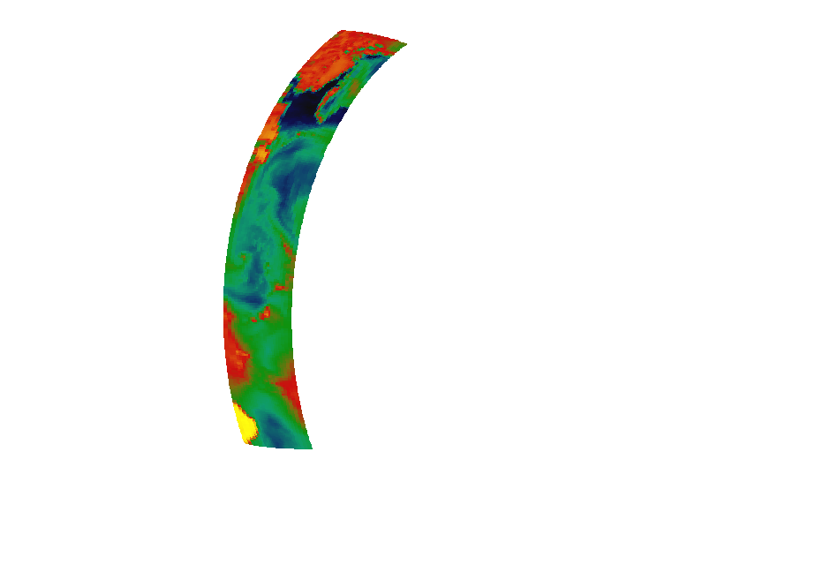
Metop-A HRPT Mitigation Activities
EARS-ATOVS from the X-Band Fast-Extract System: example coverage
Metop-A L1c products from Svalbard X-Band Fast Extract System 19 Nov 2008 – Orbits 10825 to 10829 - AMSU-A Channel 1

Slide 30
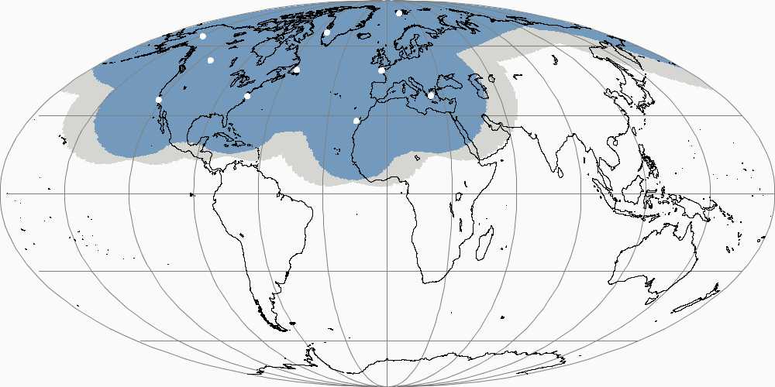
EARS Geographical Coverage: Current (24 %)
Gilmore Creek ● Edmonton ● Monterey ● Kangerlussuaq ● Gander ● Wallops Svalbard ● Lannion ● Athens ● Maspalomas

Slide 31
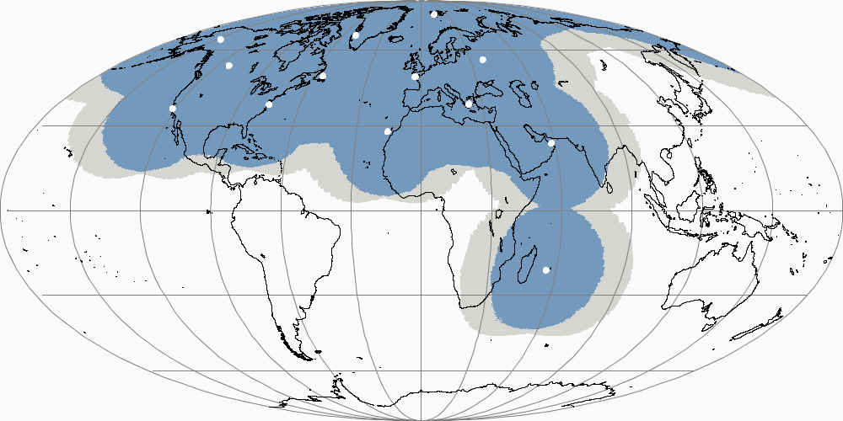
EARS Geographical Coverage: Planned (32 %)
By Adding: Moscow ● Muscat ● La Reunion

Slide 32
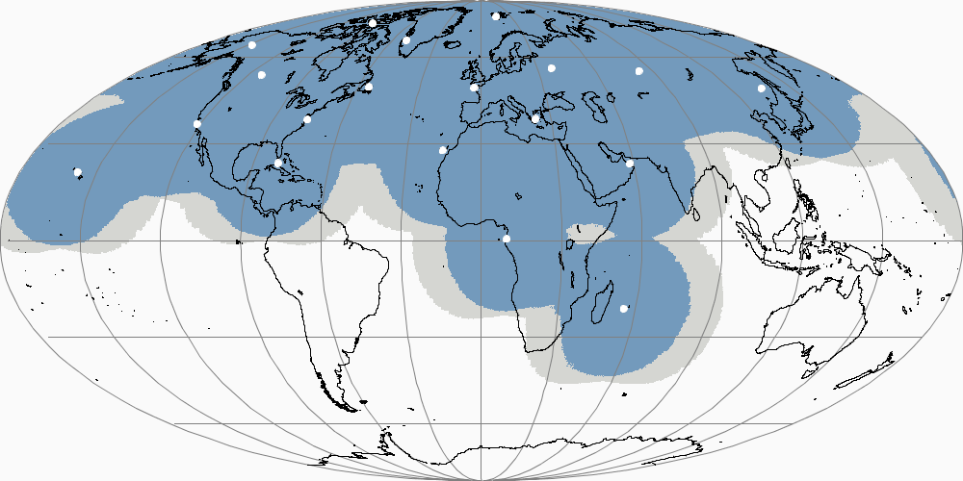
EARS Geographical Coverage: Potential (45 %)
By Adding: Hawaii ● Miami ● Resolute Bay
Libreville ● Novosibirsk ● Khabarovsk

Slide 33
Other Evolution Aspects
EARS-IASI service specification under preparation. User community consulted to provide proposals for the selection of the 300-400 channels to be included in the EARS-IASI products.
Preparations for NOAA-19 Reception and Processing ongoing.
Trial Fengyun-3 Reception and Product Processing planned at Svalbard.

Slide 34



Simplified North America / Europe data flow
internet
NOAA link
mid-term
direct reception
MeteoFrance
internet
GTS link
EARS network
North American source (eg RARS)
NESDIS link
chaos

Slide 35
Potential North America to Europe data flow
European users (NMHS)
EXGATE
European users (research)
Data grooming
EUMETCast
GTS/RMDCN
European user (xxx)
North American source (eg RARS)
order

